Slide 1

HEALTHCARE EQUIPMENT SYSTEM
A Smart Backend Solution for Managing Medical Equipment Efficiently
Spring Boot
MySQL
JPA / Hibernate
REST API
Docker
Backend Application • Equipment · Laboratory · Reservation · Maintenance Management

Slide 2

Overview
The Healthcare Equipment System is a backend application built with Spring Boot to manage medical equipment, laboratories, staff, reservations, and maintenance.
Core Domains
Manage equipment and laboratories
Equipment
Laboratories
Handle reservations and availability
Reservations
Maintenance
Track maintenance history
Role-based access for staff
Staff
MaintenanceTechnician​
RESTful APIs for integration
Healthcare Equipment System
2

Slide 3





Key Features
What the system delivers
Equipment Management
Laboratory Management
Reservation Management
Add, update, view and deactivate equipment
Manage laboratories and their equipment
Reserve equipment and check availability
Maintenance Tracking
Soft Delete (isActive)
RESTful API
Record maintenance and track history
Deactivate records instead of deleting
Well-structured APIs for front-end & systems
Healthcare Equipment System
3

Slide 4



System Architecture
Three-tier request flow
HTTP / REST
Client
Spring Boot
Application
MySQL
Database
JPA / Hibernate
Client sends HTTP requests to the Spring Boot application, which uses JPA/Hibernate to persist and retrieve data from a MySQL database.
Healthcare Equipment System
4

Slide 5
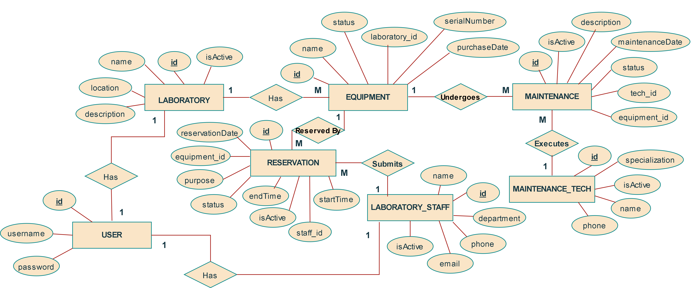
ERD — Entity Relationship Diagram

Slide 6
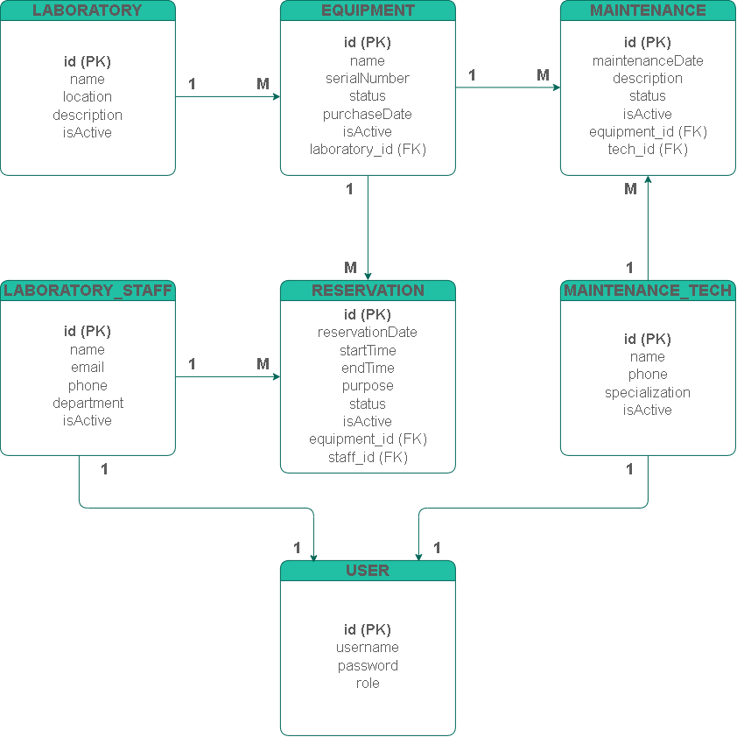
Relational Schema for Database​
Relationships
1 One * Many
Relationships
Laboratory 1 → * Equipment
Equipment 1 → * Reservation
Equipment 1 → * Maintenance
Laboratory Staff 1 → * Reservation
Technician 1 → * Maintenance
5
Healthcare Equipment System

Slide 7
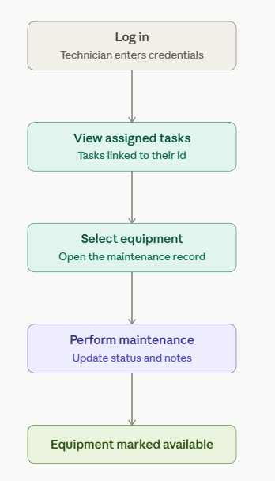
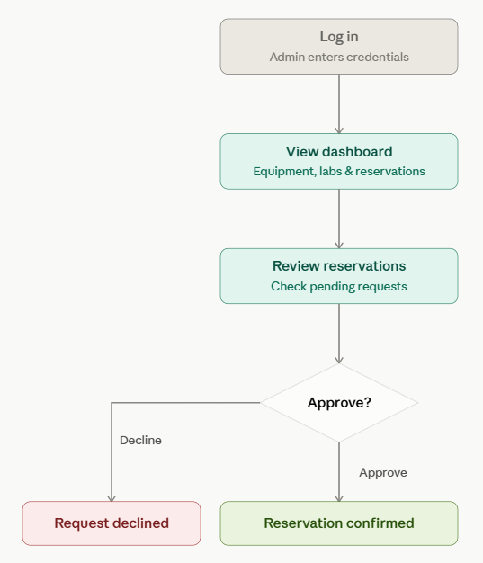
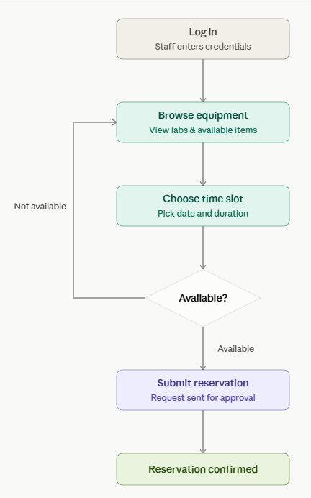
UserFlow Diagram

Slide 8
isActive in CRUD Operations
Operation
Behavior
Example
Create
Record is added with isActive = true
New equipment is active and visible.
Read
Fetch only records where isActive = true
Active equipment list.
Update
Update allowed only if isActive = true
Cannot update deactivated records.
Delete
Set isActive = false (Soft Delete)
Record is hidden but still in database.
Benefits: Keeps data history, can be restored, better for auditing.
Healthcare Equipment System
7

Slide 9




isActive — Soft Delete
Deactivating records instead of deleting them
What is isActive?
How It Works
Instead of deleting records permanently from the database, the system uses the isActive field to deactivate a record.
Add / Create
isActive = true
BaseEntity
@MappedSuperclass
public abstract class BaseEntity {
@Id
@GeneratedValue(strategy = IDENTITY)
private Integer id;
private LocalDateTime createdDate;
private LocalDateTime updatedDate;
private Boolean isActive = true;
}
Update
Update fields
Delete
isActive = false (not physically deleted)
Get / List
Fetch only where isActive = true
Healthcare Equipment System
6

Slide 10

Docker
Containerized packaging and deployment
Why Docker?
.Build & Run
Consistent environment
# Build image
docker build -t \
healthcare-equipment-system .
# Run container
docker run -p 8080:8080 \
--name hes-container \
healthcare-equipment-system
Easy deployment
Lightweight and portable
Works on any machine with Docker
.Dockerfile (Example)
FROM eclipse-temurin:17-jdk-alpine
WORKDIR /app
COPY target/*.jar app.jar
EXPOSE 8080
ENTRYPOINT ["java","-jar","app.jar"]
Healthcare Equipment System
8

Slide 11
docker-compose.yml
version: '3.8'
services:
app:
build: .
container_name: hes-app
ports:
- "8080:8080"
depends_on:
- db
environment:
SPRING_DATASOURCE_URL: jdbc:mysql://db:3306/hes_db
SPRING_DATASOURCE_USERNAME: root
SPRING_DATASOURCE_PASSWORD: root
restart: unless-stopped
db:
image: mysql:8.0
container_name: hes-mysql
environment:
MYSQL_DATABASE: hes_db
MYSQL_ROOT_PASSWORD: root
ports:
- "3306:3306"
volumes:
- db_data:/var/lib/mysql
volumes:
db_data:
How to Run
1
Make sure Docker & Docker Compose are installed.
2
Navigate to the project root.
3
Run the command: docker-compose up -d
4
Application will be available at http://localhost:8080
Healthcare Equipment System
9

Slide 12
API Endpoints
GET
/api/equipment
Get all equipment (active)
GET
/api/equipment/{id}
Get equipment by id
POST
/api/equipment
Add new equipment
PUT
/api/equipment/{id}
Update equipment
DELETE
/api/equipment/{id}
Deactivate equipment (isActive = false)
GET
/api/laboratories
Get all laboratories
GET
/api/reservations
Get all reservations
POST
/api/maintenance
Add maintenance record
Healthcare Equipment System
10

Slide 13


Technology Stack
Tools and technologies used
Java 17
Spring Boot 3.x
Spring Data JPA
MySQL 8.0
Maven
Docker
Supporting tools
•IntelliJ IDEA • Postman • MySQL Workbench • Git & GitHub
Healthcare Equipment System
11

Slide 14

Conclusion
Equipment Mgmt
The Healthcare Equipment System provides an efficient way to manage medical equipment, laboratories, reservations, and maintenance — with a scalable architecture, a soft-delete mechanism, and containerized deployment using Docker.
Laboratory Mgmt
Reservations
Maintenance
Reliable. Scalable. Maintainable.
Built for Healthcare.
Soft Delete
REST API
Docker Deploy
Healthcare Equipment System
12

